Slide 1


TEST ACCELERATOR
Valid
Test Data
Invalid
Null
GTF BUILD MANAGER
Test Reports
Editors like Eclipse, Ride
Robot Framework
Test Libraries
Automated Scripts
Test Tools
System Under Test

Slide 2
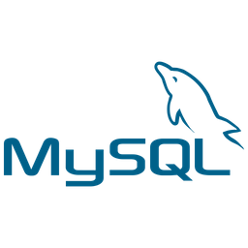

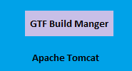



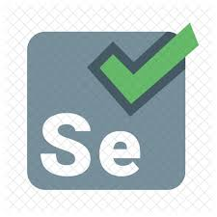



GTF Build Manager
JDBC Connection
Build
AJAX request
Reports
Start/Stop Container

Slide 3
TEST ACCELERATOR – HIGHLIGHTS
Open source
RF is application and platform independent
User doesn't need a programming language to write a Robot Framework test case & run it
Non technical person who does not have experience with programming language can contribute and learn automation, also can learn python on the go
Quick and fast implementation
Supports Keyword driven, Data-driven and Behaviour-driven (BDD) approaches
The use of Selenium2 library in RF will help a person to automate the existing manual test cases of a project in a Rapid pace
Robot Framework provides lots of libraries to test different application like Appium Library for Mobile Automation, Database Library for DB testing, Android Library etc.
Robot can be used for REST and SOAP service tests
GTF BUILD MANAGER – HIGHLIGHTS
Any person(technical/non technical) can trigger the build and view the test report any time, scheduling feature also can be implemented
Performance testing and Automation testing of various applications using different tools can be integrated under an umbrella
It provides agility
The application is built on top of open source technologies only
Provides a clean User Interface for Business Users to easily understand the product, access different Test Suites and trigger them

